Slide 1
ATA Feed ArmLink Design

Slide 2
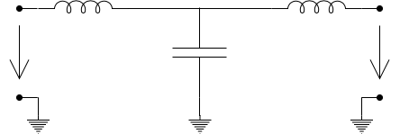
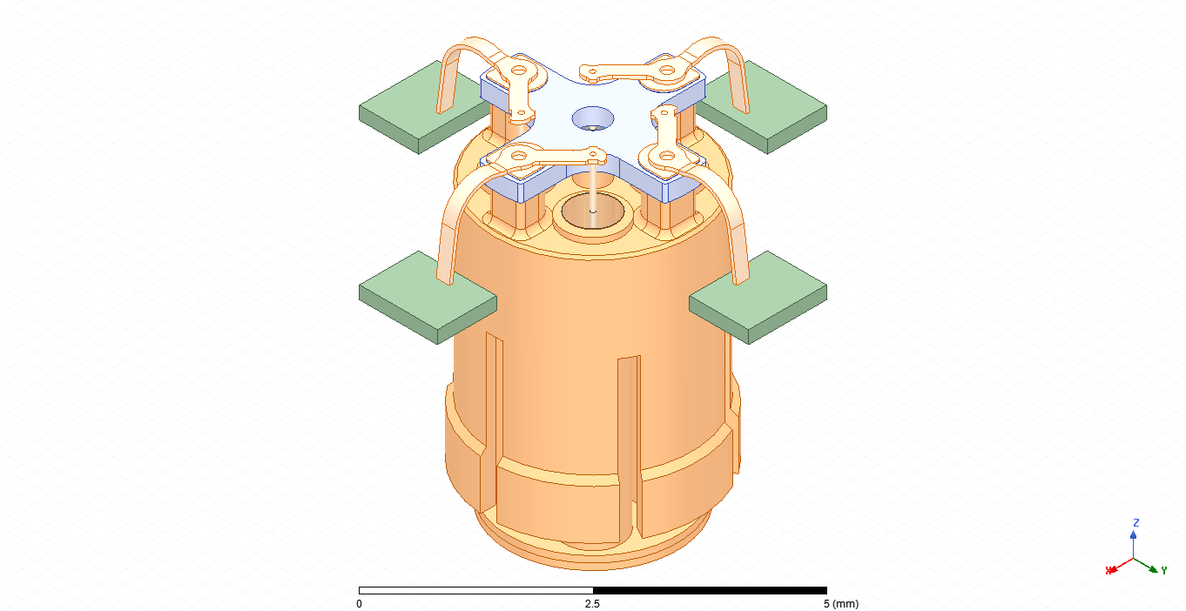
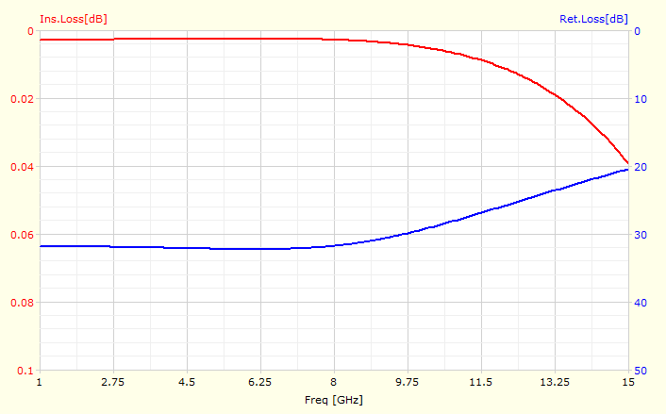
L=0.48nH
L=0.48nH
Rogers 3010
Z=100ohm
Z=95ohm
C=0.1pF
Capacitor
Coaxial Cable
Wave Port
Wave Port

Slide 3
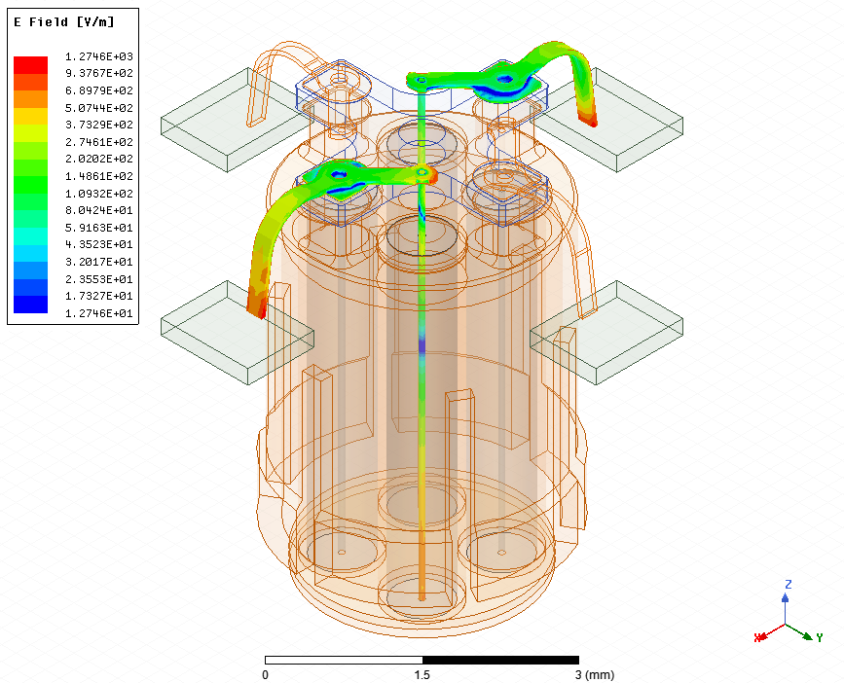
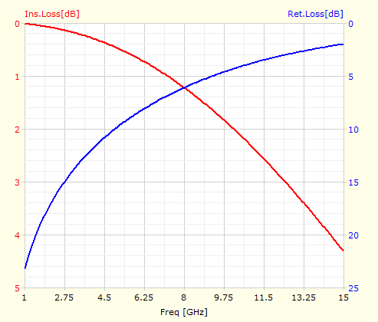
Full EM
Ideal Circuit
0.7nH
0.2nH
0.3pF

Slide 4
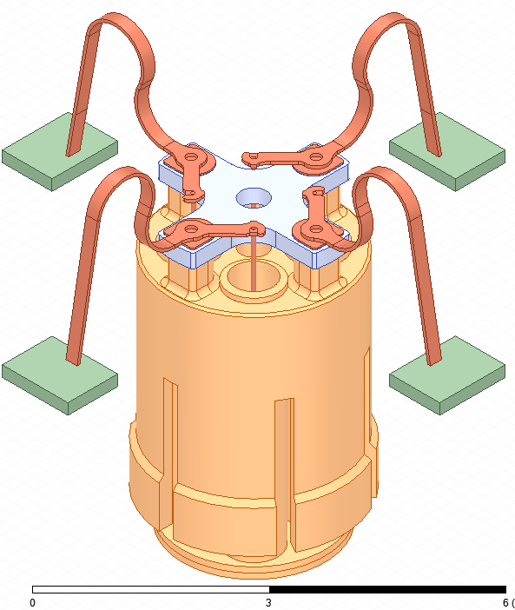
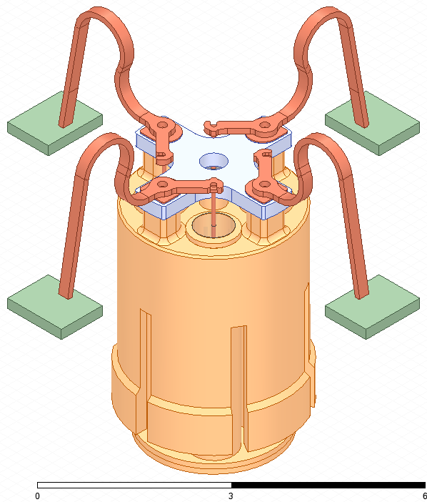
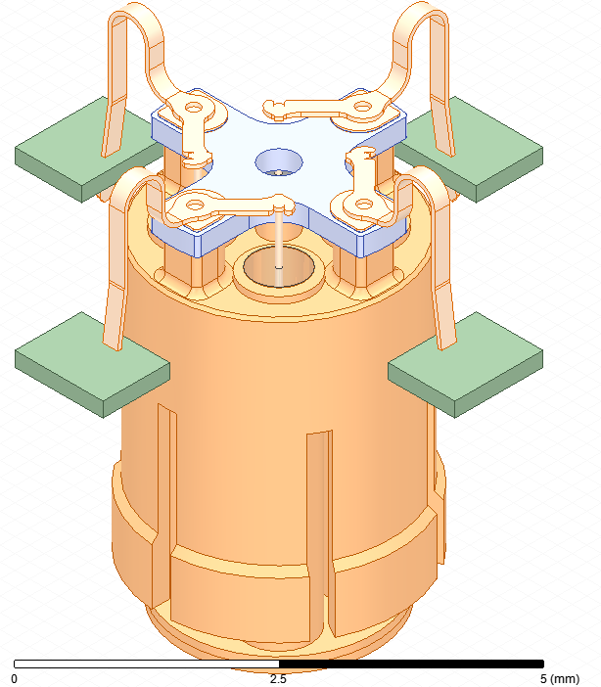
V.2
V.1
V.2.1

Slide 5
